Slide 1

THURSDAY SESSION · WEEK 21
The Bugs That Broke October
Three October vulnerabilities: what broke, how it was found, and how defenders responded
Tuesdays & Thursdays, 5:30-7:30 PM • Simons 281

Slide 2
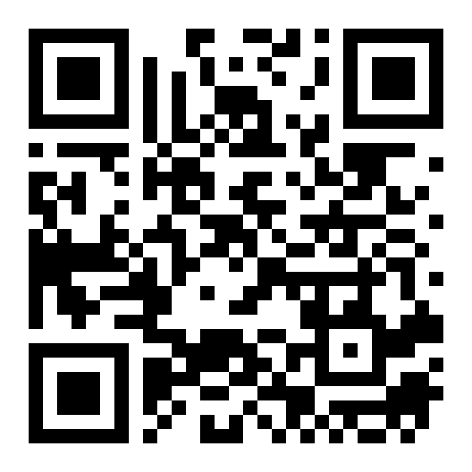
ATTENDANCE
Check in for tonight's meeting
Scan the QR code to sign in for attendance.
Requires your CofC login.
Can't scan? Go to forms.gle/ccN4CuqviXhndixq5
Scan to check in
ATTENDANCE
CofC Cybersecurity Club

Slide 3
RECAP
Quick recap: hardening a web stack
The last meeting (Thursday, Oct 29) covered locking down a web server and database, then reading access logs for scans and injection attempts. Tuesday, Nov 3 had no meeting for Election Day. Carrying forward: flaws that live in the software itself, not in its configuration.
RECAP
CofC Cybersecurity Club

Slide 4












AGENDA
Tonight's agenda
Three bugs, one month, and what defenders did about each
Terms first
PHP2Shell
CVE, CVSS, RCE, and KEV, defined before they come up.
Code execution in the language behind a large share of the web.
The leak
Broccoli2Shell
Exploit attempts started before the patch shipped.
One compression library, a long list of patches.
eMudhra's weak keys
Takeaways
Certificate keys with almost no randomness.
What changes for defenders.
AGENDA
CofC Cybersecurity Club

Slide 5

DEFINITIONS
Four terms used all session
Vulnerability reports share a vocabulary. All four terms appear in every story tonight.
CVE
CVSS
RCE
KEV
Common Vulnerabilities and Exposures. A public ID for one specific flaw, like CVE-2026-109618.
Common Vulnerability Scoring System. Rates severity from 0 to 10. A score of 9.0 or higher is critical.
Remote code execution. An attacker runs their own commands on someone else's machine.
Known Exploited Vulnerabilities. A catalog kept by CISA, the US cyber defense agency, of flaws seen in real attacks.
DEFINITIONS
CofC Cybersecurity Club

Slide 6



PHP2SHELL
PHP2Shell: CVE-2026-109618 and -109619
Two memory-safety flaws in PHP's core engine, both rated CVSS 9.2
What breaks
Who it hits
A crafted web request triggers remote code execution. No login required.
Any PHP install serving web requests, reported back to PHP 5.4. WordPress, Drupal, and Joomla sites included.
How it was found
The fix
Reported by the firm Calif with help from an OpenAI model. Wiz found related flaws with its own AI tooling.
PHP 8.5.12, 8.4.27, 8.3.36, and 8.2.35, released Oct 21.
PHP2SHELL
CofC Cybersecurity Club

Slide 7
TIMELINE
From discovery to the KEV list
The first exploit attempt came four days before the patch
Date | What happened
Summer 2026 | Calif and Wiz report the flaws to PHP. Sources differ on exact dates.
Oct 17 | Amazon's decoy servers (honeypots) log an exploit attempt. Details had leaked early.
Oct 21 | PHP ships patches and discloses both CVEs. watchTowr sees attacks in the wild.
Oct 23 | PHP discloses a separate session bug, CVE-2026-115560. Interim advice: disable session upload progress.
Oct 26 | CISA adds CVE-2026-109618 to the KEV catalog.
PHP2SHELL TIMELINE
CofC Cybersecurity Club

Slide 8
DISCUSSION
The leak
1
Think (30 sec)
Coordinated disclosure keeps a bug quiet until a fix ships. What breaks when details get out early?
2
Talk (2 min)
In pairs: you run a WordPress site on Oct 18. No patch exists. What can you do?
3
Share
Two or three answers from the room.
THE LEAK
CofC Cybersecurity Club

Slide 9
BROCCOLI2SHELL
Broccoli2Shell: CVE-2026-111497
A flaw in Google's Brotli decompression library, also called Node2Shell
What Brotli is
What breaks
A compression format that web servers and browsers use to shrink HTTP traffic.
A malicious compressed request can crash a process, leak memory, and possibly run code.
Why it spread
Mitigation
Brotli sits underneath many runtimes and proxies. Every project that ships it had to patch.
Patch the runtime. Until then, block Brotli-compressed requests or turn off Brotli decoding.
BROCCOLI2SHELL
CofC Cybersecurity Club

Slide 10
BLAST RADIUS
Who had to patch
Fixes reported as of late October
Project | Status
Node.js | Fixed Oct 21 in 22.23.4, 24.22.1, and 26.12.1.
.NET | Out-of-band fix from Microsoft, Oct 25.
Python, Bun | Fixes released.
Envoy, Istio | Fixes released for both proxies.
FFmpeg | JFrog reported an exploit path through it.
CISA KEV | Sources disagree on whether it was listed on Oct 27.
WHO HAD TO PATCH
CofC Cybersecurity Club

Slide 11

HOW HTTPS TRUST WORKS
The certificate chain
A browser trusts a website because a chain of signatures leads back to a root it already trusts.
Root CA
Intermediate CA
Site certificate
Browser
A certificate authority (CA) whose key ships inside browsers and operating systems.
Signed by the root. Handles the day-to-day signing of website certificates.
Signed by an intermediate. Proves a site's identity during TLS, the protocol behind HTTPS.
Checks every signature in the chain. Whoever holds an intermediate's private key can sign as that CA.
THE CERTIFICATE CHAIN
CofC Cybersecurity Club

Slide 12

EMUDHRA
eMudhra's weak intermediate keys
Reported Oct 17 by an independent researcher
What broke
How long
Eight intermediate CA keys had at most about 8 bits of randomness, not about 384. One was reportedly the number 4.
From the April 30, 2025 key ceremony until browsers blocked the keys on Oct 17, 2026. About 17 months.
Scope
Response
Six keys could issue TLS certificates. Two signed code. The root keys were not affected.
Chrome and BoringSSL distrusted the intermediates. eMudhra is leaving the TLS certificate business.
EMUDHRA
CofC Cybersecurity Club

Slide 13
LIVE DEMO
Recovering an 8-bit private key
2^8 = 256 possible keys. A laptop checks every one in well under a second.
from cryptography.hazmat.primitives.asymmetric import ec
# Stand-in for a CA's published public key (private key: 4)
target = ec.derive_private_key(4, ec.SECP384R1()).public_key()
for d in range(1, 2**8):
guess = ec.derive_private_key(d, ec.SECP384R1()).public_key()
if guess.public_numbers() == target.public_numbers():
print("Private key found:", d)
break
Predict first: how long does the loop take? Vote, then run it.
LIVE DEMO
CofC Cybersecurity Club

Slide 14

TAKEAWAYS
What defenders take from October
AI-assisted research is surfacing serious flaws in long-trusted software
Old code, new findings
Patch windows shrink
AI tools helped find PHP2Shell, a flaw reported back to PHP 5.4 from 2012.
Attacks on PHP2Shell started before the patch. Watch the KEV catalog, not only vendor advisories.
Know your dependencies
Process is security
Broccoli2Shell reached apps that never chose Brotli. A software bill of materials (SBOM) lists what's inside.
eMudhra's cryptography was sound. Its key-generation process failed.
TAKEAWAYS
CofC Cybersecurity Club

Slide 15
WHERE THIS CAME FROM
Resources & citations
Wiz: PHP2Shell
CISA: Critical vulnerabilities in PHP
wiz.io/blog/php2shell-php-rce
cisa.gov/news-events/alerts/2026/10/21
NPR: AI found the flaw, hackers found the leak
The Hacker News: CVE-2026-115560
npr.org/2026/10/24/nx-s1-6012327
thehackernews.com/2026/10/urgent-php-warns-of-another-unpatched.html
BleepingComputer: Node2Shell exploited
DigiCert: Broccoli2Shell response
bleepingcomputer.com/news/security
digicert.com/blog/broccoli2shell-exposure-risk-and-response
Dart SDK advisory: eMudhra certificates
SOCRadar: eMudhra CA key compromise
github.com/dart-lang/sdk/security/advisories/GHSA-frr6-h895-5pxp
socradar.io/blog/emudhra-ca-key-compromise-weak-keys-risks-and-fixes
RESOURCES
CofC Cybersecurity Club

Slide 16

NEXT SESSION
Tuesday: Ask Anything, Break Anything
Next time we'll tour the club range, cover enough Linux to move around it, and break things on purpose. Bring a laptop with an SSH client.
Simons 281, College of Charleston
Tuesdays & Thursdays, 5:30-7:30 PM
Questions on tonight's material? Ask in #defense-team
NEXT UP
CofC Cybersecurity Club

